Slide 1
CONTEXT FREE GRAMMAR (CFG) Session 07
Course : Comp6062 – Compilation Techniques
Effective Period : September 2021

Slide 2
Learning Outcomes
At the end of this meeting, students are expected will be able to:
Apply the theory of Context Free Grammar
Recognize and differentiate the grammar
Conversion from RE directly to CFG

Slide 3
Outline Material
Chomsky Classification
Definition of Context Free Language(CFG)
Grammar Derivation
Parsing Tree
Language of a Grammar
Ambiquous Grammar
Conversion of RE to the CFG

Slide 4
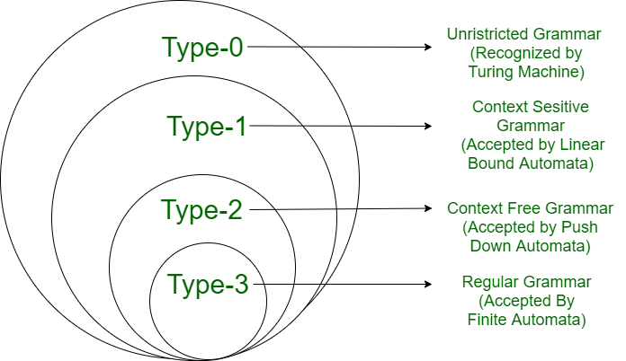
Chomsky Classification

Slide 5
Chomsky Classification
Grammar | Languages | Automaton | Production rules (constraints)*
Type-0 | Unrestricted Grammar | Turing machine | α ◊ β (no constraints)
Type-1 | Context-sensitive Grammar | Linear-bounded automaton | ◊ β |α| <= |β|
Type-2 | Context-free Grammar | pushdown automaton | ◊ β α ∊ V β ∊ (V|T)*
Type-3 | Regular Grammar | Finite state automaton | ◊ β α ∊ V, β ∊ VT | T Atau α ∊ V, β ∊ TV | T

Slide 6
CONTEXT FREE GRAMMAR (CFG)
Define programming language, used to describe document formats, such as Document Type Definition (DTD) that is used in XML
There is an automaton called ‘PushDown Automaton’ (PDA), that also describe all and only CFG
Formality of parsing concept
Define mathematical expression.

Slide 7
CONTEXT FREE GRAMMAR (CFG)
Formal Definition of CFG :
G = (V, T, P, S)
where :
V : set of variabel
T : set of terminal
V ∩ T = ∅ (disjoint)
P : set of production : A → α
A : variabel
α∈ ( V ∪ T )∗
S : start symbol

Slide 8
CONTEXT FREE GRAMMAR (CFG)
Grammar Derivation :
Production example:
1. <sentence> → <subject> <predicate>
2. <subject> → <noun>
3. <predicate> → <verb> <object>
4. <object> → <noun>
5. <noun> → dog⎥ rice⎥ people
6. <verb> → eat⎥ hit
< ….. > : variabel
⎥ : alternative or Choice

Slide 9
CONTEXT FREE GRAMMAR (CFG)
application of the above is through "derivation" process repeatedly will result in a complete sentence, example:
"People eat rice",
"Dog eat dog",
Wrong Sentence :
"Hit the dog“
"Eating rice people"

Slide 10
Derivation
Derivations : Production derivation process from top to bottom (head to body)
Derivation symbol : ⇒
Left Most Derivation (LMD): derivation performed on the leftmost variable.
Right Most Derivation (RMD): derivation performed on the right variables.

Slide 11
CONTEXT FREE GRAMMAR (CFG)
Grammar Derivation :
Production example:
1. <sentence> → <subject> <predicate>
2. <subject> → <noun>
3. <predicate> → <verb> <object>
4. <object> → <noun>
5. <noun> → dog⎥ rice⎥ people
6. <verb> → eat⎥ hit
< ….. > : variabel
⎥ : alternative or Choice
Example of Derivation of “dog eat dog” :
<sentence> ⇒ <subject> <predicate>
⇒ <subject> <verb> <object>
⇒ <subject> <verb> <noun>
⇒ <subject> <verb> dog
⇒ <subject> eat dog
⇒ <noun> eat dog
⇒ dog eat dog

Slide 12
CONTEXT FREE GRAMMAR (CFG)
CFG for writing arithmetic expressions.
Production for the expression of arithmetic:
E → E + E
E → E * E
E → (E)
E → a | b | c | d

Slide 13
CONTEXT FREE GRAMMAR (CFG)
Derived the arithmetic expression : “(a+b)*c”
E ⇒ E ∗ E ⇒ (E) ∗ E ⇒ (E + E) ∗ E
⇒ (a + E) ∗ E ⇒ (a + b) ∗ E ⇒ (a + b) ∗ c
Derivations notation repeatedly :
⇒ : Derivation m times in a row in the
grammar G
⇒ : Derivation of 0 or more times in a row in the grammar G
m
G
*
G

Slide 14
CONTEXT FREE GRAMMAR (CFG)
Convertion using symbol :
1. A, B, C, D, E and S : variabel
2. Lowercase and digit : terminal
3. X, Y, Z : terminal or variabel
4. Lowercase : u, v, w, x, y, and z : string variabel
Lowercase : α, β, γ : sentential form (V∪T)*
when A → α₁, A → α₂, …, A → α_{n}, is written
A→ α₁ ⎟ α₂⎟ …⎟ α_{k}

Slide 15
Derivation Tree
Derivation Tree :
Depiction of derivation in the form of tree A ⇒ XYZ
Tree : A Parse Tree for : - (id + id)
X Y Z

Slide 16
Language for CFG
Definition :
Language for CFG G : L (G) = { w ⎟ w ∈ T* and S ⇒ w }
where : w ∈ T* : terminal
S ⇒ w : derived from S
L is “Context Free Language” when there are CFG G, so that L = L(G).
Example of CFG : G = (V, T, P, S)
where : V = {S}
T = {a, b}
P = {S → aSb, S → ab }
Derivation of grammar:
S ⇒ aSb ⇒ aaSbb … a^{n}b^{n}
Then :
L(G) = { a^{n}b^{n} ⎟ n ≥ 1}
*
*

Slide 17
Conversion RE to CFG
All Regular Language can be defined by the CFG, but does not apply in reverse.
Conversion from RE to CFG:
RE = ε S → ε
RE = ∅ (Production of S can not produce a terminal string )
RE = a S → a
RE = a + b S → a | b
RE = a.b S → ab
RE = a* S → aS | ε
RE = a⁺ S → aS | a

Slide 18
Example
Make a CFG for the language with :
RE = (ab + ba)* (abb)*
A B
Answer:
Production of CFG
P: S → A B
A → CA | ε
C → ab | ba
B → DB | ε
D → abb
so CFG G = {V,T,P,S}
With V = {S,A,B,C,D}
T = {a,b}
P : see the left side

Slide 19
Ambiguous Grammar
Grammar ambiguous: There is a string in T * which have more than one LMD or RMD over one or more of a Parse Tree. If every string in L (G) has at most one parse tree, then G is called unambiguous.
There is a language that can not be found unambiguous grammar. Computer language grammar that should generate unambiguous.
Problem:
if for a grammar can be decided as unambiguous grammar or not? If it can not be ascertained, then there is no algorithm for it which can ensure the long-step process to determine the problem.

Slide 20
Ambiguous Grammar
Example : parse tree for a+a*a
T1 T2
E
E
E
+
E
E
E
*
a
E
*
E
E
+
E
a
a
a
a
a

Slide 21
Ambiguous Grammar
There are ambigous grammar (not all) that can be converted into unambiguous grammar.
For the CFG can be transformed into an arithmetic expression grammar unambigous :
E → T | E + T
T → F | T * F
F → I | (E)
I → a | b | c
There is no algorithm to convert from ambiguous to unambiguous grammar.

Slide 22
Ambiguous Grammar
A CFL L is called inherently ambiguous if all CFG grammar for L is ambiguous.
Example : L =
This Language have Context Free Grammar as follow :
S → AB | C
A → aAb | ab
B → cBd | cd
C → aCd | aDd
D → bDc | bc

Slide 23
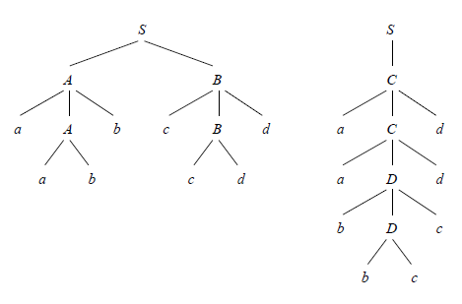
Parse tree for string ‘aabbccdd’ :

Slide 24
Exercises
Construct a CFG for RE below :
a* b* (a│c)*
(a│c)* ba
(( 00 + 01 )* 01) + (101 ( 0 + 10)*)

Slide 25
References
Hopcroft, John E., Motwani, Rajeev, Ullman, Jeffrey D. (2007). Introduction to automata theory, languages, and computation. 3rd. Addison-Wesley. New York. ISBN: 9780321476173, Chapter 5.1- 5.2 (page 169-190), 5.4 (page 205-214), 7.1 (page 255-262)
http://www.univ-orleans.fr/lifo/Members/Mirian.Halfeld/Cours/TLComp/l3-CFG.pdf
http://www.andrew.cmu.edu/user/ko/pdfs/lecture-8.pdf

